Slide 1
Evolution of Cloud Computing

Slide 2
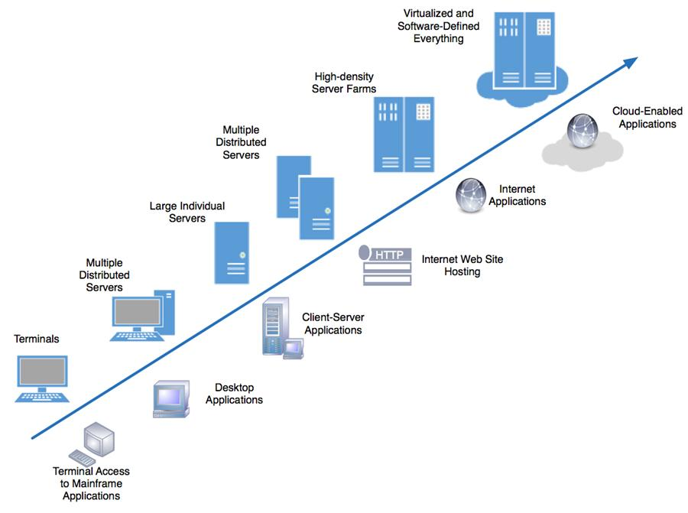
Computing Paradigm Shift

Slide 3
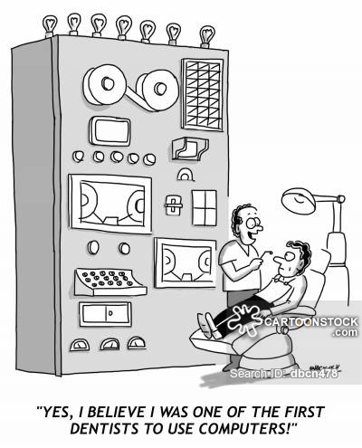
Mainframe Computing
Jobs
Batches
Processing
To carry out some mundane and routine jobs such as payroll, accounts, inventory thus sparing employees from tedious jobs.
It was available in one location, and anyone who needs it must go to computer centre for availing it.

Slide 4
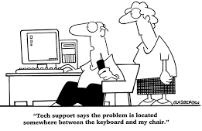
Personal Computing
Desktop computing - personal computer small enough to fit conveniently in an individual workspace.
Providing computers to each employee on their desktop or workspace.
Decentralized computing.
Less expensive, easy to upgrade and less accessories needed.
Information sharing with other users is a tedious process.

Slide 5
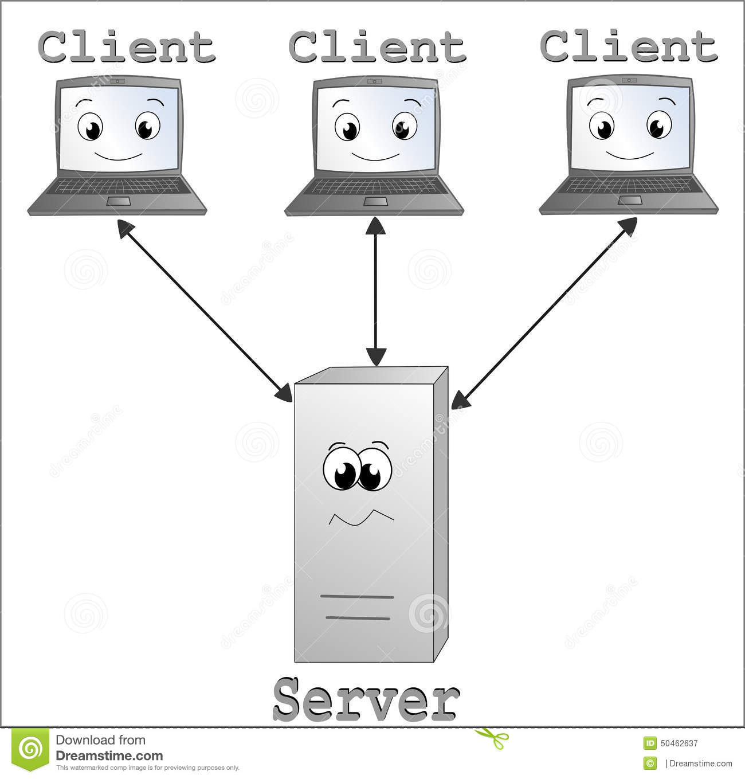
Network Computing
Networked computers - Local Area network (LAN) achieved this.
In the networked computing model- a relatively powerful computer- server is loaded with all software needed
Each user to provided with a connected- terminal to access and work

Slide 6
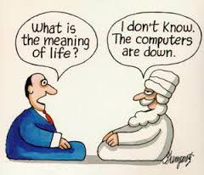
Internet Computing
Network computing such as LAN connected uses within an office or institutions.
Internet computing - connect organizations located in different geographical locations.

Slide 7
Cluster Computing
A computer cluster is a group of linked computers, working together closely thus in many respects forming a single computer.
The components of a cluster are connected to each other through fast local area networks.
Clusters are mainly used for load balancing and providing high availability.
Requirements for computing increasing fast.
More data to process.
More compute intensive algorithms available.

Slide 8
Cluster Computing
Benefits
Drawbacks
High Availability.
Reducing cost.
Manageability.
Problem in Finding Fault.
The machines in a cluster are dedicated to work as a single unit.
The computers in the cluster are normally contained in a single location.

Slide 9
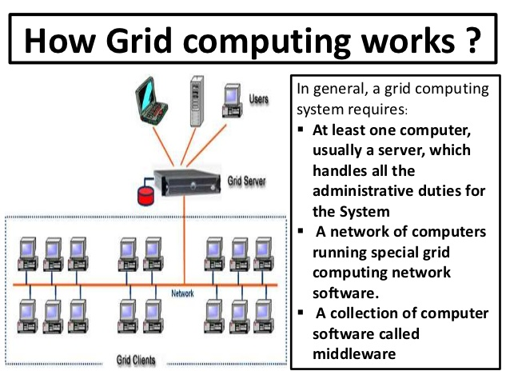
Grid Computing
Computing power available within an enterprise is not sufficient to carry out the computing task.
Data required for the processing is generated at various geographical locations.
GC requires the use of software that can divide and farm out pieces of a program as one large system image to several thousand computers.

Slide 10
Grid Computing
Benefits
Drawbacks
Enables applications to be easily scaled .
Better utilization of underused resources .
Parallelization of processing .
Proprietary approach should be eliminated.
There is a single point of failure if one unit on the grid degrades.
No pay as you go

Slide 11
Grid Computing vs Cluster Computing
Cluster is homogenous.
The cluster computers all have the same hardware and OS.
The computers in the cluster are normally contained in a single location
Grids are heterogeneous.
Run different operating systems and have different hardware.
Grid are inherently distributed by its nature over a LAN, metropolitan or WAN.

Slide 12
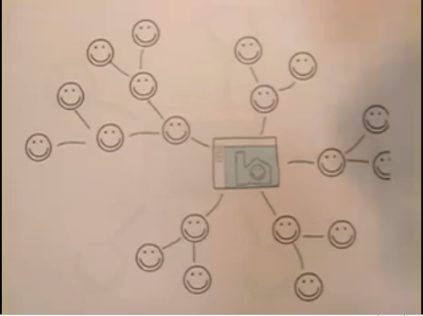
Cloud Computing ??

Slide 13
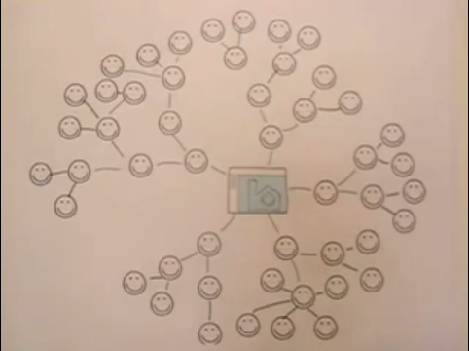
Cont.

Slide 14

Conti.

Slide 15
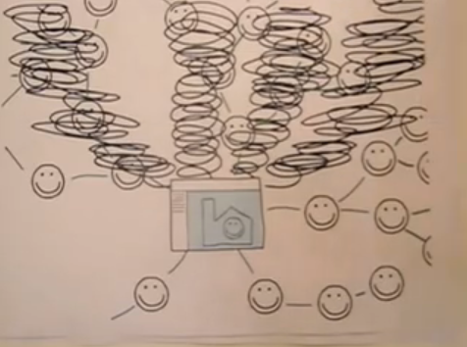
Cont.

Slide 16
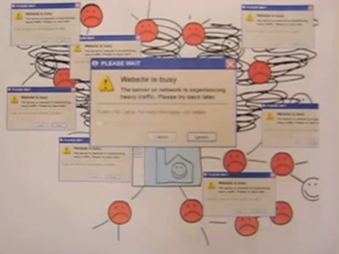
Conti.

Slide 17

Two Solutions
Buy more servers and recourses.
Move to Cloud

Slide 18
Cloud Computing
Cloud Computing refers to both the applications delivered as services over the Internet and the hardware and systems software in the datacenters that provide those services.
The datacenter hardware and software is what we will call a Cloud.
The practice of using a network of remote servers hosted on the Internet to store, manage, and process data, rather than a local server or a personal computer.

Slide 19
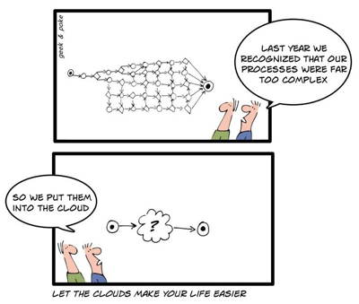
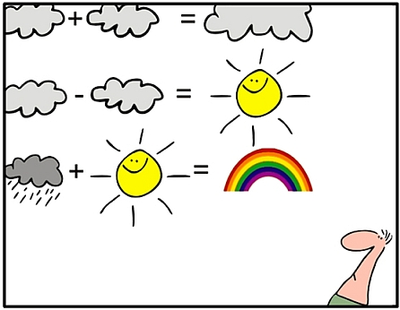
Cloud Computing
GC helped to gather computing power from other institutions.
Used by only by participating organizations or privileged people.
Lack of commercial model in GC.

Slide 20
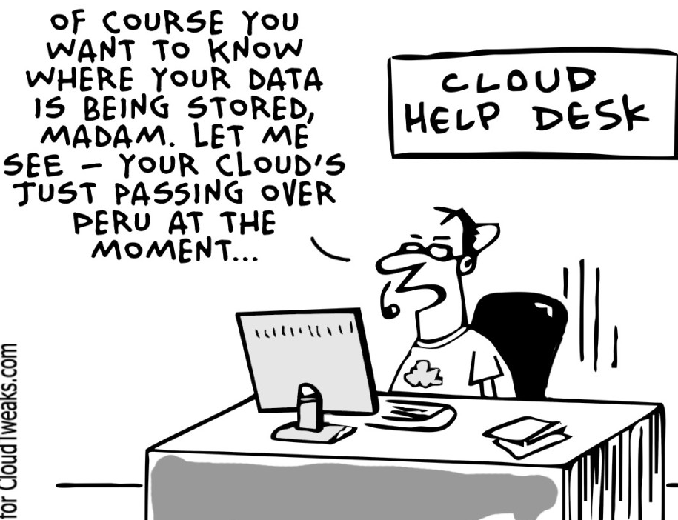
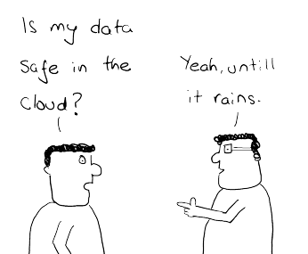
Cloud Computing
Benefits
Drawbacks
Disaster recovery
Increased Scalability
Faster Deployment
Metered Service
Highly Automated
Constant Internet Connection
High Speed Internet Required
Data Stored is not secure

Slide 21
Grid Vs Cluster Vs Cloud Computing
Properties | Cloud | Cluster | Grid
On-demand self- Service | Yes | No | No
Broad network access | Yes | Yes | Yes
Resource pooling | Yes | Yes | Yes
Rapid elasticity | Yes | No | No
Measured service | Yes | No | Yes

Slide 22
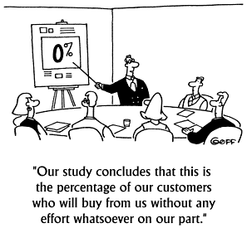
Terms in Computing - QoS
Quality of service
Quality of service ( QoS) is a set of technologies for managing network traffic in a cost effective manner to enhance user experience for home and enterprise environments .
Now QoS is defined by ,
Customer care evaluations
Technological evaluations

Slide 23
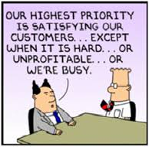
Terms in Computing - SLA
Service Level Agreements
A service-level agreement (SLA) is a contract between a network service provider and a customer that species, usually in measurable terms ( QoS), what services the network service provider will furnish.

Slide 24
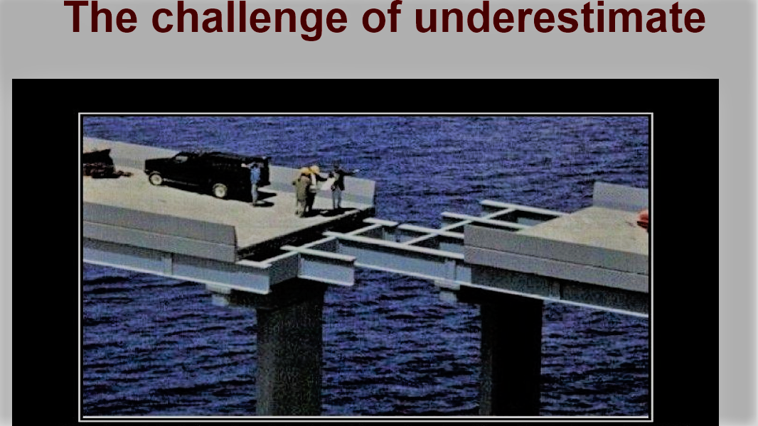
Terms in Computing – Scalability and Elasticity
Scalability
A desirable property of a system, a network, or a process, which indicates its ability to either handle growing amount of work in a graceful manner or to be readily enlarged.
Elasticity
The ability to apply a quantifiable methodology that allows for the basis of an adaptive introspection with in a real time infrastructure.
But how to achieve these properties ?
Dynamic provisioning
Multi-tenant design

Slide 25

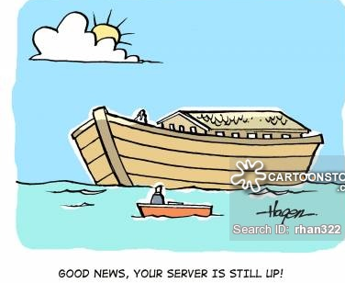
Terms in Computing – Availability and Reliability
Availability
Degree to which a system, subsystem, or equipment is in a
specified operable and committable state at the start of the
mission, when a mission is called for at an unknown time.
Reliability
The ability of a system or component to perform its
required functions under stated conditions for a specified
period of time.
Availability and Reliability can be achieved by ,
Fault-tolerant systems
Require system resilience
Reliable system security

Slide 26
Terms in Computing – Manageability and Interoperability
Manageability
Systems manageability is strongly affected by network management initiatives in telecommunications.
Interoperability
A property of a product or system, whose interfaces are completely understood, to work with other products or systems, present or future , without any restricted access or implementations
But how to achieve above two ?
System control automation
System state monitoring

Slide 27

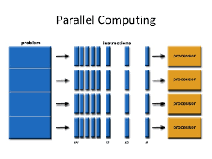
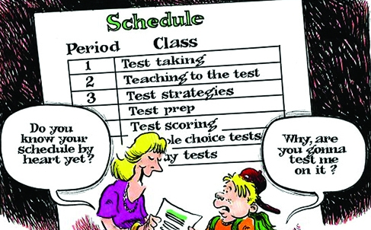
Terms in Computing – Performance & Optimization
Application performance should be guaranteed.
Use of powerful infrastructure or other underlining resources to build up a highly performed and highly optimized environment, and then deliver the complete services to end users.
Parallel computing
Load balancing
Job scheduling

Slide 28
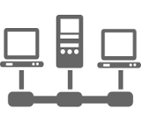
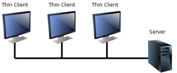
Terms in Computing – Accessibility & Portability
Accessibility
A general term used to describe the degree to which a product, service, or environment is accessible by as many people as possible.
Portability
Service portability is the ability to access services using any device, anywhere, continuously with mobility support and dynamic adaptation to resource variations
How can we achieve this??
Uniform access
Thin client

Slide 29
Thanks

